Slide 1

Heat Loss and Gain
Civil Engineering and Architecture
© 2010 Project Lead The Way, Inc.

Slide 2
Heat Loss and Gain
Heat Transfer
Heating System Design
Cooling System Design
British Thermal Units (Btu)
Formula for Heat Load
Heat Loss Through a Wall
Wall R-Value
Convert R-Value to U-Factor
Using Engineering Design Data
ΔT = Temperature Differential
Total Heat Transmission Load

Slide 3
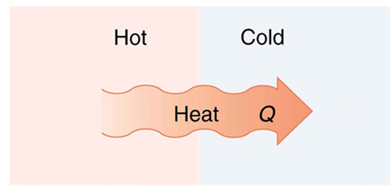
Heat Transfer
Heat transfer is the exchange of thermal energy between physical systems (depending on the temperature and pressure) by dissipating heat.
  Always occurs from the region of high temperature to the region of lower temperature.
  Thermal equilibrium is reached when all bodies and the surroundings reach the same temperature.
  Fundamental modes of heat transfer
      Conduction
      Convection
      Radiation

Slide 4
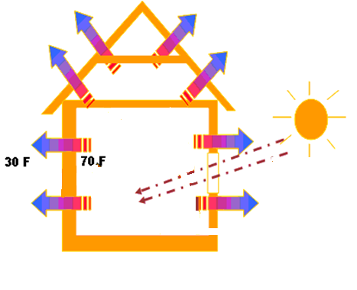
Heat Transfer
Creating a comfortable interior environment while using energy efficiently is a common goal in building design.
Reducing heat transfer between the interior and exterior environments is often a priority in designing energy-efficient buildings.
Notes:
It is important to note, however, that in some cases heat transfer is desirable.
For example, in cold climates during the winter, radiant heat from the sun allowed to pass through fenestrations (windows and skylights) can be collected and stored in “thermal mass,” such as concrete slabs, brick walls, and floors. The stored thermal energy can then be transferred into the living space through natural convection and radiation. This process is referred to as passive solar heating and can reduce the energy demands to heat the building.

Slide 5

Heat Transfer
Thermal Conduction: The process of heat transfer through a solid by transmitting kinetic energy from one molecule to the next.

Slide 6

Heat Transfer
Thermal Convection: Heat transmission by the circulation of a liquid or gas.

Slide 7
Heat Transfer
Radiant Heat: Energy radiated or transmitted as rays, waves, or in the form of particles.

Slide 8
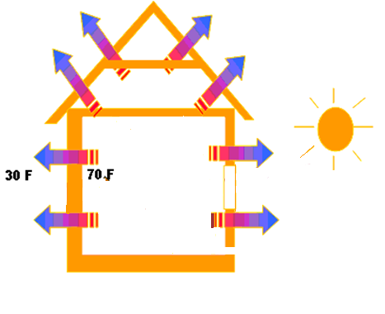
Heat Transfer
Which mode of heat transfer is represented by each type of arrow?.
Convection
Radiation
Conduction
Notes:
Which type of heat transfer occurs when heat is passed through the building envelope (walls, roof, doors) and is represented by these arrows? [click]
How is heat transferred through transparent materials such as sunlight through windows and skylights? [click]
What mode of heat transfer occurs when warm air is lost through openings, cracks, and air leaks? [click]

Slide 9


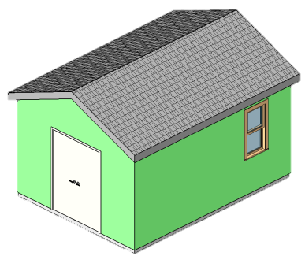
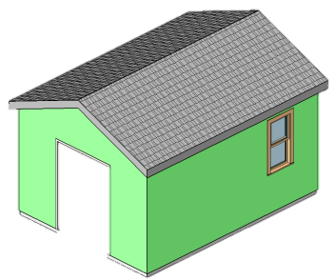
Heat Transfer
Heat loss occurs in the winter when a heating system warms the inside air
  the outside temperature is lower than the inside temperature
Heat gain occurs in summer when air conditioning cools the inside air
  the outside temperature is higher than the inside temperature

Slide 10
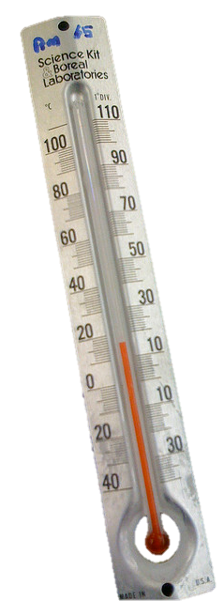
Heating System Design
In order to effectively heat a space, the heating system must provide at least as much thermal energy as is lost through heat transfer.
It is desirable to minimize heat loss
  Minimize conductance through the thermal envelope
    Insulation with higher R-value
    Windows and skylights with lower U-factor
  Minimize convection
    Eliminate air leaks in building envelope
Notes:
The solar radiation that actually enters a building through a window can be reduced by adding reflective coatings or low-E coatings, adding a gas between panes, or tinting the glass. The fraction of incident solar radiation that actually enters a building through a window is defined as the Solar Heat Gain Coefficient (SHGC). We will talk more about SHGC in a later unit.
The International Residential Code (IRC) prescribes specific building materials and construction techniques to address insulation and fenestration (windows and skylights) thermal requirements as well as to limit air leakage from the building. We will discuss the IRC in more detail in the next lesson.

Slide 11
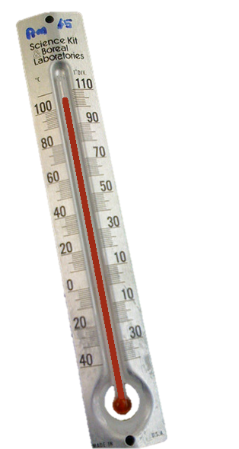
Cooling System Design
In order to effectively cool a space, the cooling system must remove at least as much thermal energy as is added through heat transfer.
Additional thermal loads for cooling
  Solar radiant heat gain through windows
  Occupant heat gain is about 250 Btu/h per occupant, or up to 715 Btu/h if occupant is exercising
  Equipment heat gain from equipment such as computers, coffee makers, etc.
  Lighting heat gain
Notes:
In addition to the thermal conduction through the building envelope and air convection through leaks considered when designing a heating system, there are additional heat gains that must be considered when designing a cooling system.
The solar radiation that actually enters a building through a window can be reduced by adding reflective coatings or low-E coatings, adding a gas between panes, or tinting the glass. The fraction of incident solar radiation that actually enters a building through a window is defined as the Solar Heat Gain Coefficient (SHGC). The IRC specifies SHGC for residential construction. We will talk more about SHGC in a later unit.
In this unit, we will concentrate on the conductance of thermal energy through the building envelope.

Slide 12
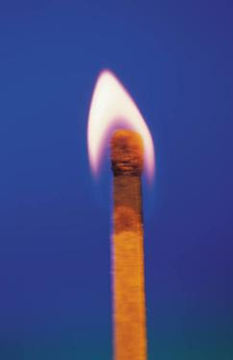
British Thermal Unit (Btu)
Unit of energy used in the United States
A Btu is defined as the amount of heat required to raise the temperature of one pound of water by one degree Fahrenheit
One Btu is about the amount of energy produced by a burning match.
Notes:
In order to design or select a heating or cooling system, we must quantify the amount of energy needed to maintain a comfortable inside temperature.
We quantify energy using British Thermal Units (Btu). Heating and cooling systems are often rated by their capacity in Btu per hour (Btu/h).

Slide 13
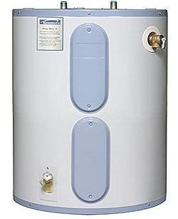
British Thermal Unit (Btu)
Fahrenheit is a common temperature scale used by engineers in heating, ventilation, and air conditioning (HVAC).
Btu/h is a way of measuring the heating power of a system such as a furnace, hot water heater, or a barbecue grill.

Slide 14
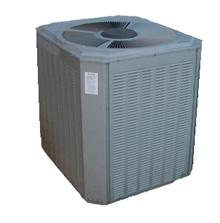
British Thermal Unit (Btu)
1 watt is approximately 3.4
12,000 is referred to as a ton in most North American air conditioning applications

Slide 15
British Thermal Unit (Btu)
R-Value: The measurement of thermal resistance used to indicate the effectiveness of insulation.
    Units:
U-Factor (coefficient of heat conductivity):
The measure of the flow of transmittance through a material given a difference in temperature on either side.
    Units: Note that R = 1/U
Notes:
Note the difference in terminology. R-VALUE and U-FACTOR.

Slide 16
Formula for Heat Load
Q' = AU ΔT
Where Q' = Total cooling/heating load in
A = Area under investigation in ft²
U = Coefficient of heat conductivity in
ΔT = Difference in temperature between outside and inside conditions in °F
Click here to return to calculation
Notes:
This formula calculates thermal heat conductance through a solid.
The rate of heat flow, Q prime, is equal to the product of the area of the surface under investigation, the U-factor, and the different between the inside and outside temperature.

Slide 17
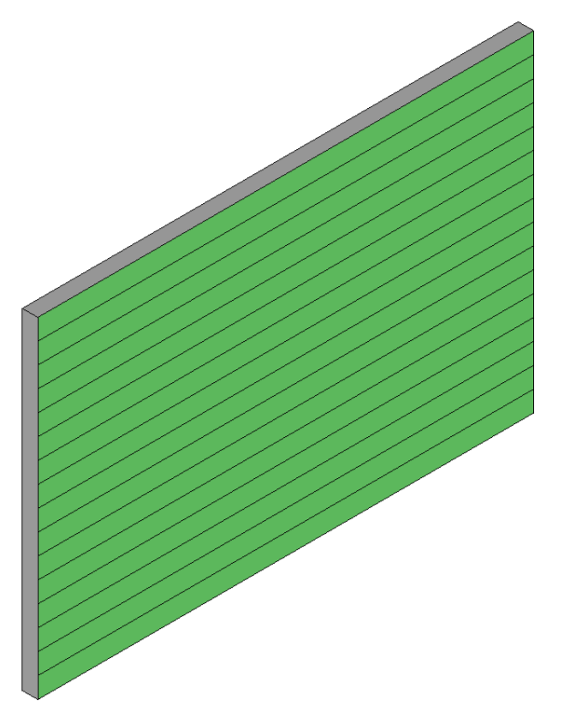
Heat Loss Through a Wall
No windows or doors
Height = 8 ft
Length = 12 ft
Area = 8 ft x 12 ft = 96 ft²

Slide 18
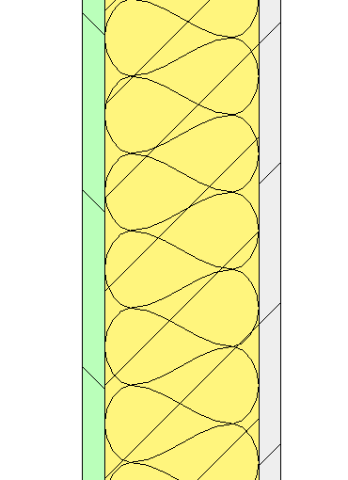
Wall R-Value
Outside Air Film neglect
Siding 1.05
Insulation 13.00
Drywall 0.68
Inside Air Film 0.68
Total R-Value 15.41
Notes:
We can obtain the U-factor by calculating the R-value of the wall assembly and then taking the reciprocal. To find the R-value of the wall assembly, simply sum the R-value of all of the wall components.
The inside air film is simply a thin film of air that adheres to the inside face of the building envelop component (such as a wall or roof). That thin file of air provides a small amount of resistance to heat transfer. Technically there is also an outside air film that also provides some resistance to heat transfer; however, the R-value of the outside air film is very dependent on the outside environmental conditions and typically much smaller that the R-value of the inside air film. Therefore, we will ignore the R-value of the outside air film.

Slide 19
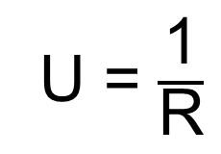
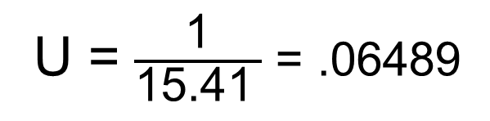
Convert R-Value to U-Factor
Total R-Value= 15.41
U = .064
(Do not round up)
Notes:
When expressing the U-factor, it is common practice to simply truncate the number (that is, drop digits after the third decimal place). Do not round up.

Slide 20
Using Engineering Design Data
Choose your nearest location using the data from one of the following
International Plumbing Code
Local weather data
National Oceanic and Atmospheric Administration (NOAA) Engineering Weather Data

Slide 21
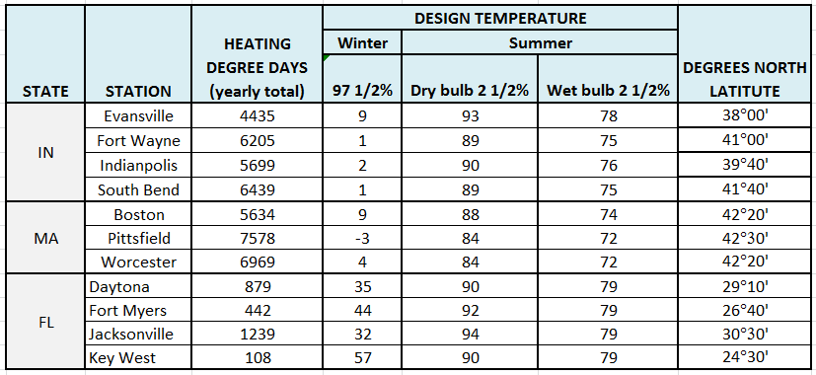
Using Engineering Design Data
Source: 2012 International Plumbing Code, Table D101
Use 97 ½% value for heating calculations. A 97.5% value has been exceeded 97.5% of the year. In other words, during approximately 355 days in the year, the temperature exceeds this value
(365 x .975 = 355.9 days).
Use 2 ½% value for cooling calculations. A 2.5% value has been exceeded only 2.5% of the year. In other words, during approximately 9 days in the year, the temperature exceeds this value
(365 x .025 = 9.1 days).
Notes:
The International Residential Code for One- and Two-family Dwellings (IRC) provides minimum standards for the construction of one- and two- family residential structures. We will discuss the IRC in more detail in the next lesson.
The 2012 IRC reflects the applicable residential requirements of the 2012 International Energy Conservation Code. The code(s) notes that the Winter Design Temperature is “the outdoor design dry-bulb temperature as shall be selected from the columns of 97¹/₂-percent values for winter from Appendix D of the International Plumbing Code. Deviations from the Appendix D temperatures shall be permitted to reflect local climates or local weather experience as determined by the building official.” (2012 IRC Table R301.2(1) Climatic and Geographic Design Criteria, note e.)
In Activity 2.2.3 Heat Loss and Gain, you will calculate the heat loss during the winter for a shed located in Boston, MA. Therefore, you will use the 97.5% design temperature of 9 °F in your calculations.

Slide 22
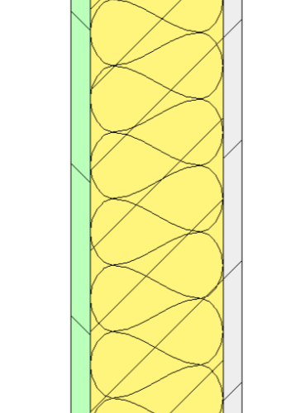
ΔT = Temperature Differential
The difference between the design outside temperature and the design inside temperature
Design Outside Temperature
4 °F
Design Inside Temperature
68 °F
(in Worcester, MA)
Notes:
The 97 ½% design outside temperature for Worcester, MA is 4 °F (as shown on the previous slide) taken from the 2012 International Plumbing Code Table D101.

Slide 23
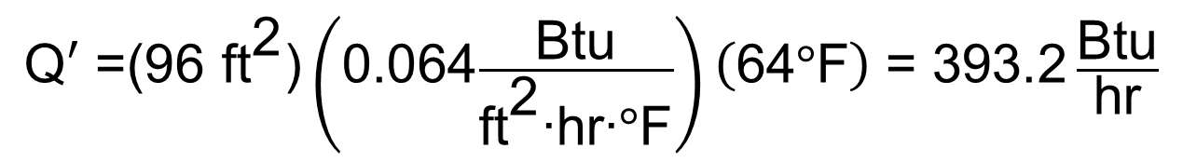
Total Heat Loss
(or Transmission Load)
Q' = AU ΔT
A = (8 ft) (12 ft) = 96 ft²
U = .064
ΔT = 68°F - 4°F = 64 °F
°F
$$\text{Q}′\text{ =(96 }{\text{ft}}^{\text{2}}\text{)}\left(\text{0.064}\frac{\text{Btu}}{{\text{ft}}^{\text{2}}\text{∙}\text{hr}\text{∙}\text{°}\text{F}}\right)\left(\text{64}\text{°}\text{F}\right) \text{= 393.2} \frac{\text{Btu}}{\text{hr}}$$
Click here to see equation
Notes:
Note that we are only considering the heat loss/gain caused by the transmission of heat through the building components. Other causes of heat loss or gain (such as lighting, people, equipment, air infiltration, etc.) are not considered. Therefore, for our purposes, when we refer to heat loss/gain we are referring to the heat loss/gain caused by this transmission.

Slide 24
Heat Loss and Gain
Heat Transfer
Heating System Design
Cooling System Design
British Thermal Units (Btu)
Formula for Heat Load
Heat Loss Through a Wall
Wall R-Value
Convert R-Value to U-Factor
Using Engineering Design Data
ΔT = Temperature Differential
Total Heat Transmission Load

Slide 25
Image Resources
Microsoft, Inc. (n.d.). Clip art. Retrieved June 10, 2009, from http://office.microsoft.com/en-us/clipart/default.aspx

