Slide 1
Design Brief
Introduction
© 2011 Project Lead The Way, Inc.

Slide 2
Design Brief
One way to define the problem is through the use of a design brief.
This concise document (no more than one page) identifies the client, clearly states his/her problem or need, details the degree to which the engineer will carry out the solution, and lists the rules and limits within which the engineer must perform.
Notes:
Typically a design brief is completed after the problem has been identified, brainstorming has occurred and research has been conducted.

Slide 3
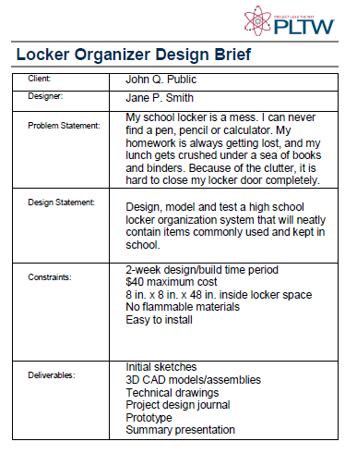
Design Brief
The design brief serves as an agreement between the client and the engineer.
Notes:
The engineer will often return to the design brief throughout the design process in order to check progress and validity of the creative work.

Slide 4
The Client
The client is usually a person, company, organization, or target consumer group whose problem requires the talents of an engineer or designer to develop a physical solution.

Slide 5
The Designer
The designer is the creative problem- solver.

Slide 6
Problem Statement
The problem statement clearly and concisely identifies the problem.

Slide 7
Problem Statement
Example of a good problem statement:
My school locker is a mess. I can never find a pen, pencil, or calculator. My homework is always getting lost; my lunch gets crushed under a sea of books and binders. Because of the clutter, it is hard to close my locker door completely.

Slide 8
Design Statement
The design statement challenges the engineer to take action to address the need and to solve the problem.

Slide 9
Design Statement
Example of a good design statement:
Design, model, and test a high school locker organization system that will neatly contain items commonly used and kept at school.

Slide 10
Constraints
Constraints can be thought of as guidelines that must be followed or rules that must not be broken. Examples:
Time
Budget
Physical Attributes (size, weight, color, etc.)
Safety
Codes

Slide 11
Deliverables
Deliverables are the end product(s) that the engineer/designer and client decide are appropriate for this design problem.

