Slide 1
Automation and Robotics
Automation and Robotics VEX
© 2011 Project Lead The Way, Inc.

Slide 2
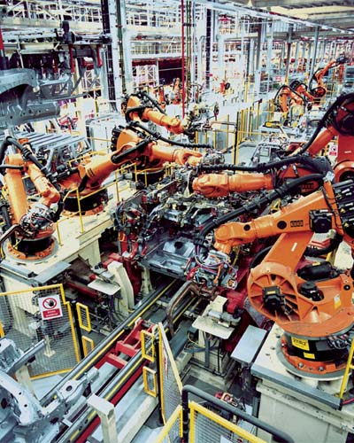
What is the Difference?
Automation involves a mechanical device that can imitate the actions of people or animals.
Robotics involves the design, construction, and operation of a robot.
A robot is a machine that performs complicated tasks and is guided by automatic controls.

Slide 3
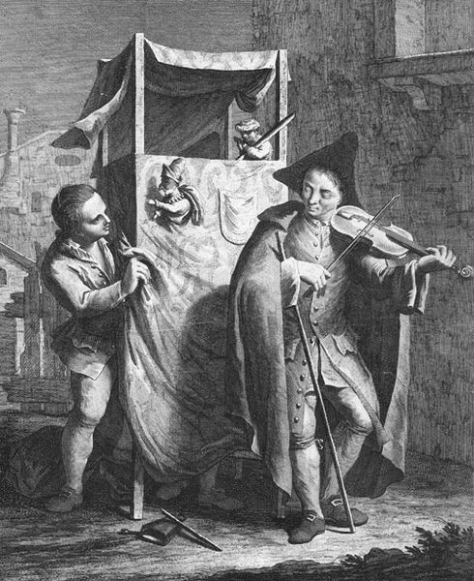
Robot Generations
Machines, like the puppets in this theater, were designed to imitate human actions over 3,000 years ago.

Slide 4
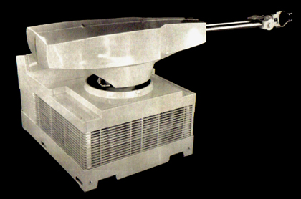
Robot Generations
First generation robots were designed to perform factory work.
Such robots performed simple tasks that were dangerous or unpleasant for people.
Robots were used to weld, spray paint, move heavy objects, handle hot materials, etc.
1961 - The first industrial robot was online in a General Motors automobile factory in New Jersey. It was called UNIMATE. It was used to pick up and put down parts.
Notes:
Robots were and are used extensively for mass production of products. Without robots many products would be even more expensive than they are today.

Slide 5
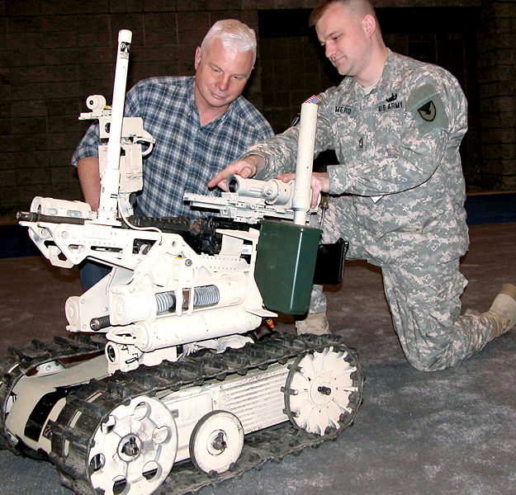
Robot Generations
Second generation Robots perform more complex tasks and simulate many human functions.
Such robots move, sense surroundings, and respond to changes in their environment.
SWORDS on Display U.S. Army Sgt. 1st Class Jason Mero (right) describes the capabilities of the SWORDS (Special Weapons Observation Remote Direct-Action System) robot to Garth Renn, an attendee at the Washington Auto Show, Washingon Convention Center in Washington D.C., Jan. 24, 2006. Defense Dept.
photo by Gerry J. Gilmore.

Slide 6
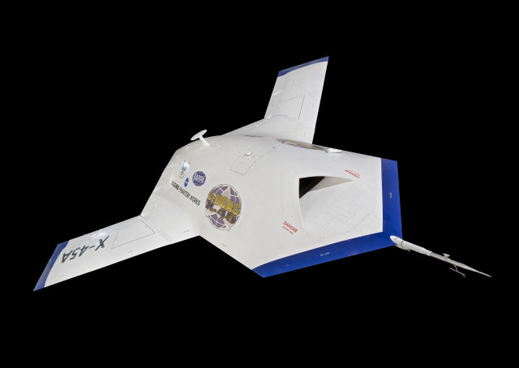
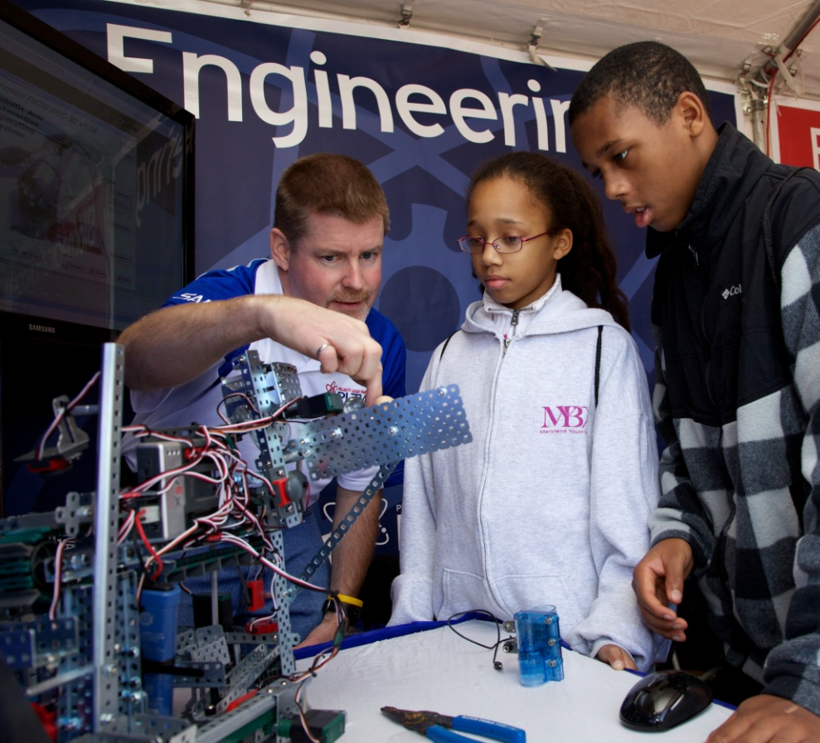

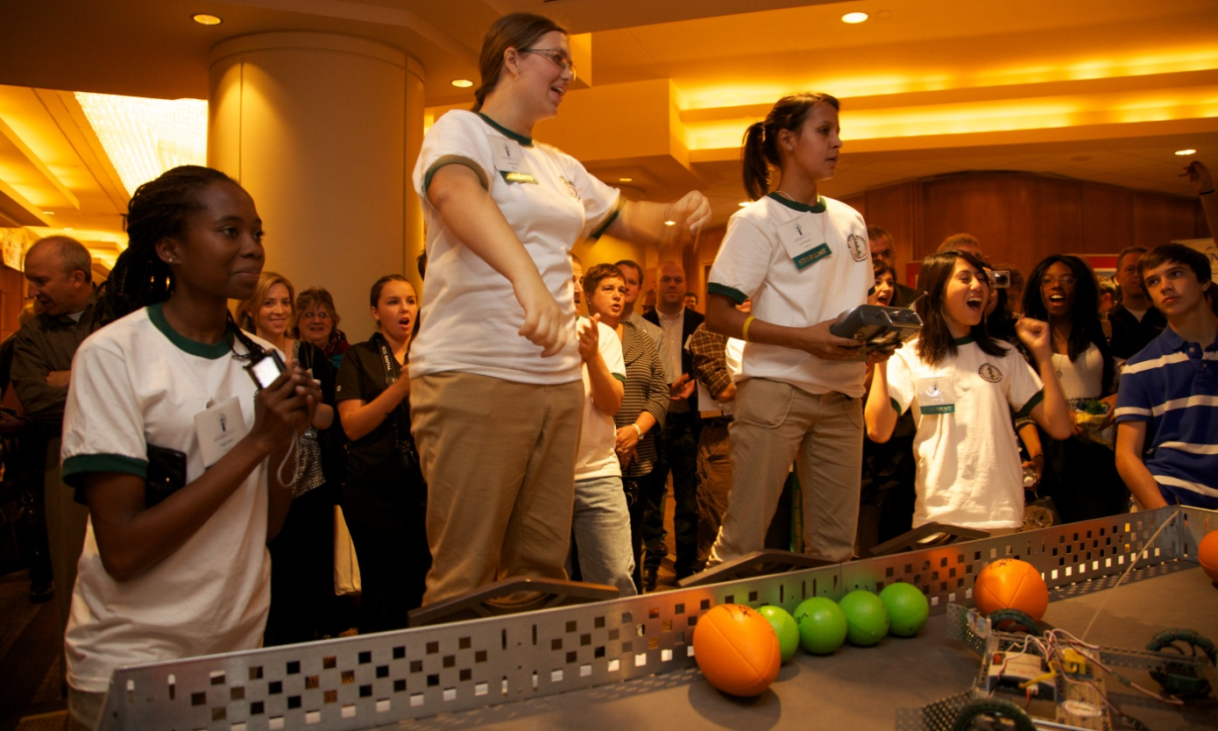
Robots are Used For
Precision work
Repetitive/monotonous work
Dangerous work
Exploration
Education
Competition
Unmanned combat aerial vehicles must do precise, repetitive and dangerous work.
Notes:
Precision Work - Programming a robotic arm to make something like a peanut butter and jelly sandwich could take hundreds of instructions. That is why in factories that use robotic devices, each device is designed and programmed to do just a few steps of the manufacturing process over and over again. The item being manufactured goes from one robotic station to the next until it is completed.
Robots can be programmed to do things that humans would grow tired of very easily or cause damage to the human body by repetitive movements (weld cars together, stack boxes, and so on).
Dangerous Work Robots can be designed to perform tasks that would be difficult, dangerous, or impossible for humans to do. For example, robots are now used to defuse bombs, service and clean nuclear reactors.
Robots are used to explore the depths of the ocean and the far reaches of space. Quasi-autonomous unmanned aerial vehicles are now undertaking many of the military's most dangerous reconnaissance and strike missions.
Robotics in Education - The field of robotics is quickly becoming an exciting and accessible tool for teaching and supporting science, technology, engineering, mathematics (STEM), design principles, and problem solving. Robotics enables students to use their hands and minds to create like an engineer, artist, and technician does, all at once.
Competitive Robotics -Robotics competition is designed to provide people of all ages, backgrounds, and levels of study with the opportunity to demonstrate their knowledge and understanding of design, manufacturing processes, materials, programming, and other technologies. Students are judged on their application of technology principles to solve the challenge, knowledge of engineering concepts that aid them in solving the problem, and their ability to solve real-world problems in a team environment as they work together to overcome their opponents, all while having fun.

Slide 7
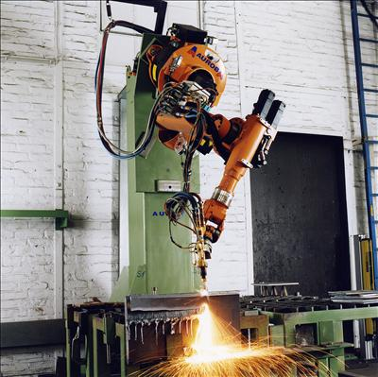
Today’s Robots
Industrial robots perform many factory jobs
  Welding
  Painting
  Assembly
Notes:
Robots are often used for the 4 D’s. To perform dirty, dull, or dangerous tasks, or to help someone with a disability.
Industrial robots are often used to perform tasks that are unsafe or boring for people.

Slide 8
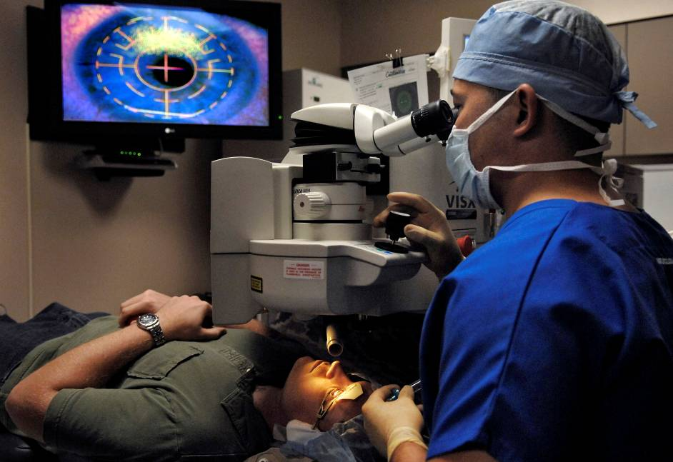
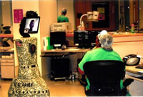
Today’s Robots
Medical Robots
  Assist with surgery
  Transport materials
  Dispense medicine
  Communicate
Lt. Col. Charles Reilly performs laser eye surgery on Senior Airman John Paul Marsh Aug. 23 at the newly opened Defense Department Joint Warfighter Refractive Surgery Center at Lackland Air Force Base, Texas.
The mobile robot (left) can roll to a patient's bedside and enable two-way, real time communication between a physician and a patient, patient's family, other physicians, and nurses. Photo by Army Institute of Surgical Research, September 28, 2007.
Notes:
Surgeries are delicate procedures that benefit from the accuracy and steadiness of the robotic arm. Robotic hands can work in areas too small for a human hand.
Tug is a robot that can be trained to pull hospital carts. Tug can carry medical records, food, and medications to wherever they are needed.
Robots are used to fill hospital prescriptions. Robots are more accurate in counting and measuring the prescription for the patient.

Slide 9
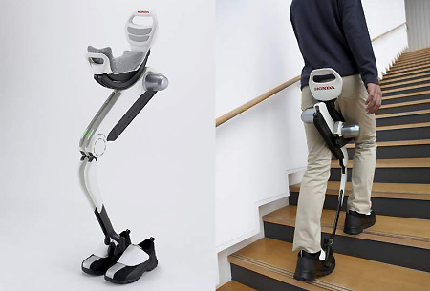
Today’s Robots
Assistive Robots
  Eating
  Walking
  Cleaning
  Grasping/reaching
EL-E The Robot
Notes:
People with a disability may have difficulty performing everyday tasks. Assistive robots help with those tasks.
Make sure you’re connected with the Internet. Click on Video to play. EL-E is a robot that can pick up objects and deliver them using a laser pointer.

Slide 10

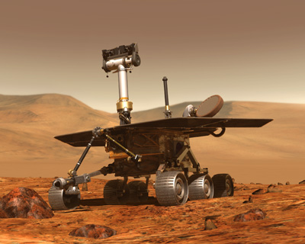
Today’s Robots
Explore
  Space
  Underwater
  Military

Slide 11
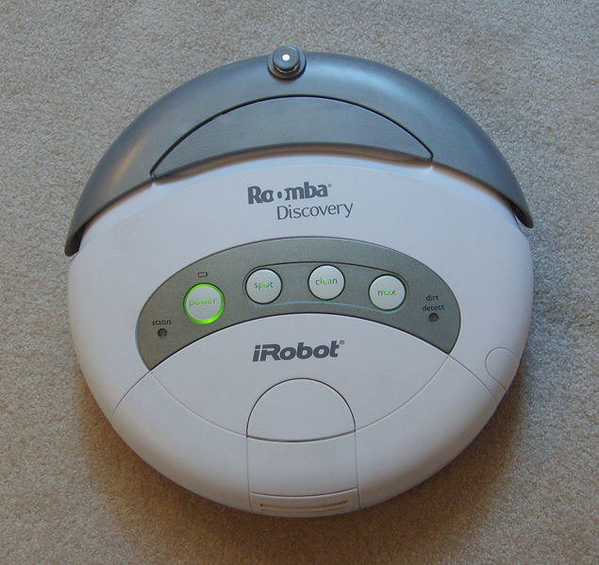
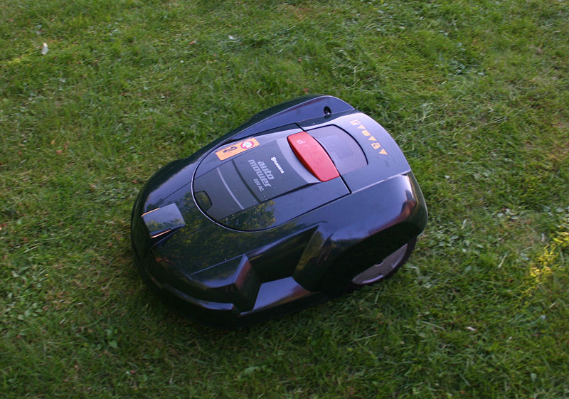
Today’s Robots
Household Robots
  Vacuum
  Mow lawn
  Clean

Slide 12
Image Resources
Air Force Photos (n.d.). Retrieved November 10, 2008, from http://www.af.mil/photos/ media_search.asp?q=laser&page=3
Honda Walk Assist (2008). Retrieved April 27, 2009, from media.techeblog.com/images/hondawalkingassist.jpg
Smithsonian National Air and Space Museum. (2009) Boeing X-45A join unmanned combat air system. Retrieved June 3, 2009, from http://www.nasm.si.edu/imagedetail.cfm?imageID=1868
U.S. Department of Defense (2006). Retrieved November 100, 2008, from http://www.defenselink.mil/news/ newsarticle.aspx?id=14536

